Slide 1

Variational Quantum Algorithm for Solving Partial Differential Equations
Yilian Liu

Slide 2
Overview
Motivation
Variational Quantum Algorithms
Cost Function Design for Linear equations
Nonlinear equations
Challenges
Notes:
Today we are going to talk about

Slide 3
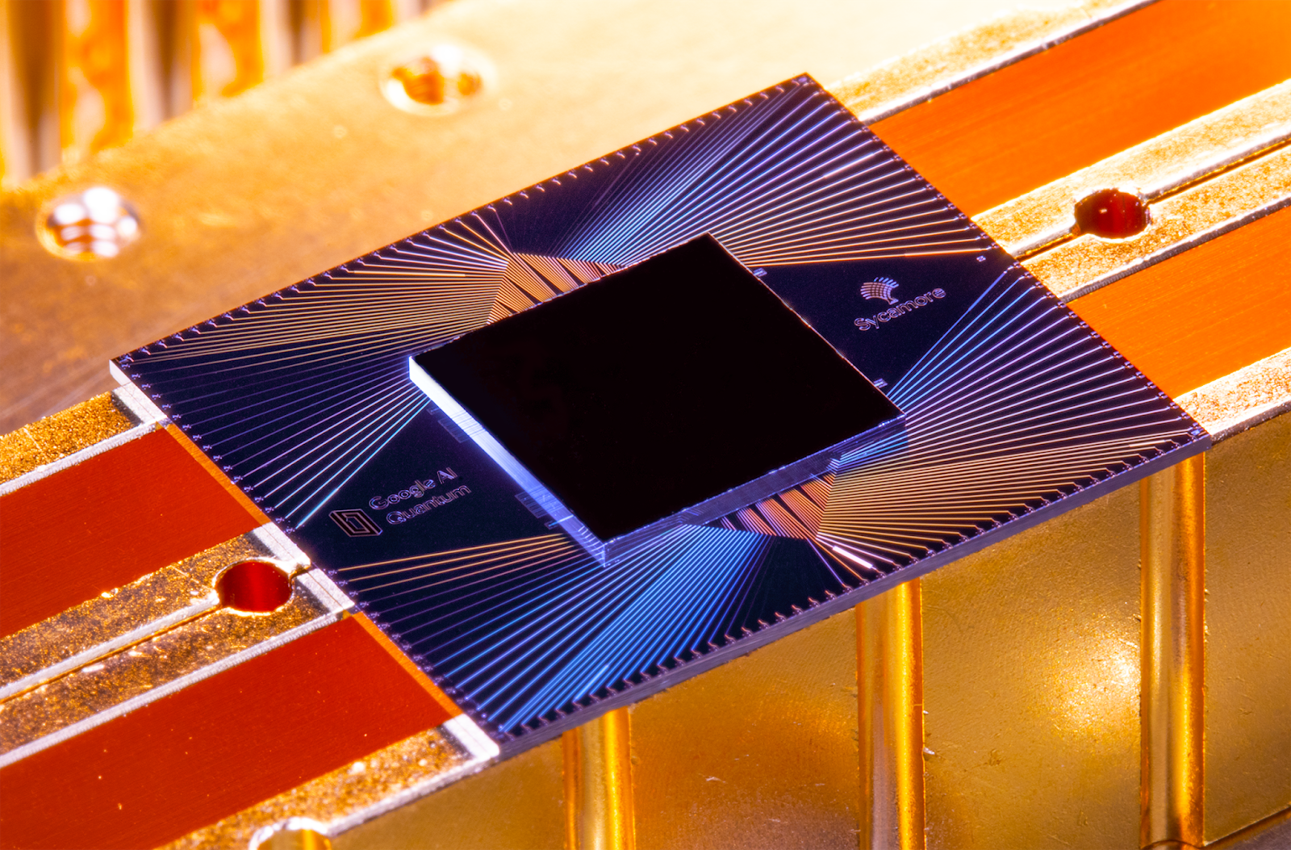
Motivation
Quantum Computers:
Information scales exponentially with the number of qubits
Exponentially large matrix multiplications
Noisy, analog machines
Goal: Utilize the power of quantum computers to solve classically expensive PDEs
Google A.I. Quantum’s Sycamore processor. Credit...Erik Lucero/Google

Slide 4
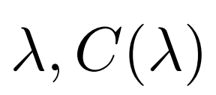


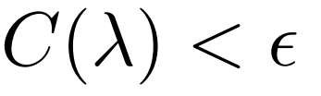
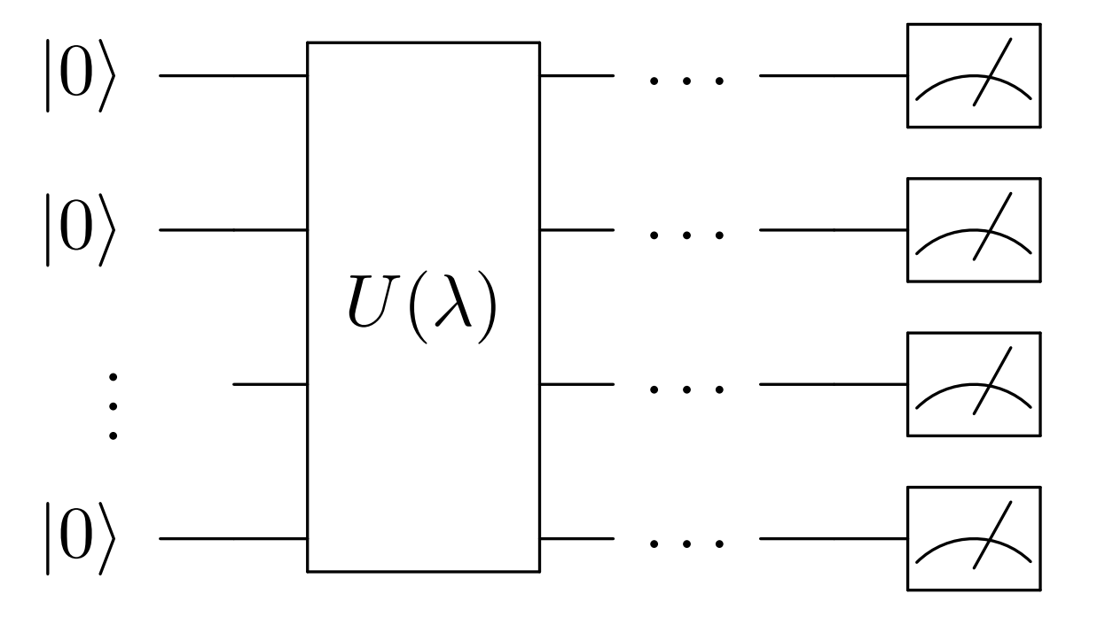

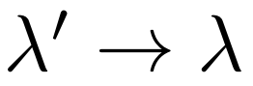
Variational Quantum Algorithm
Ansatz Circuit
Initial Parameters
Cost Function
if
return
Classical Optimizer
Introduced by Lubasch et al. [1]
Notes:
Lambda is a list of parameters
Caveat: in general for VQA, output is not lambda and cost is not zero

Slide 5
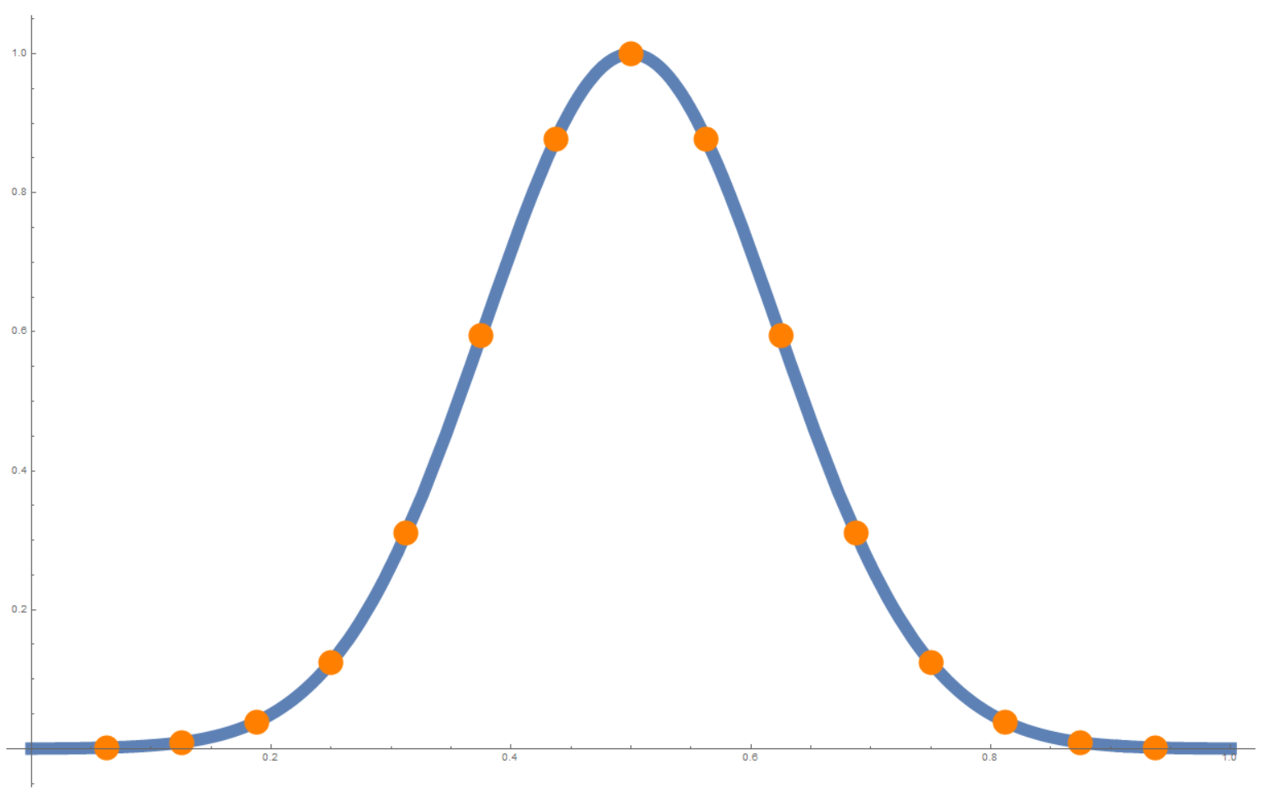
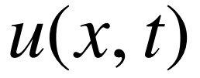
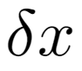
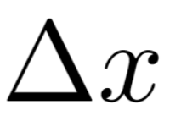
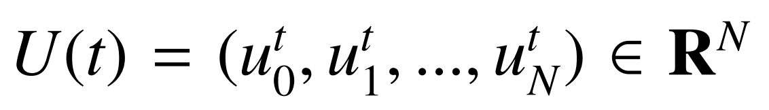
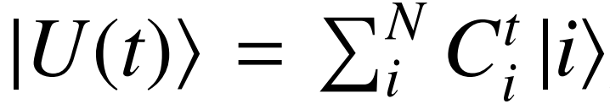
Discretization
at t=0
With grid spacing
Vector Form
Quantum State

Slide 6
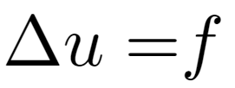
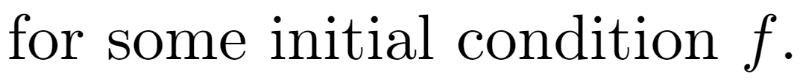
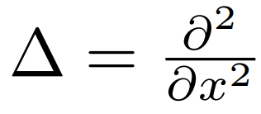
1D Poisson Equation

Slide 7
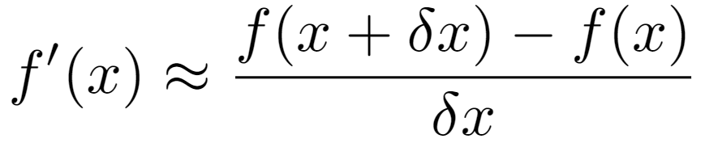
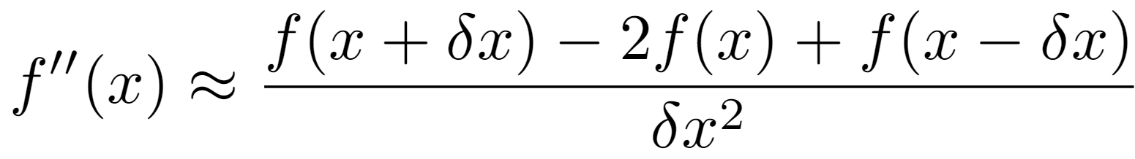
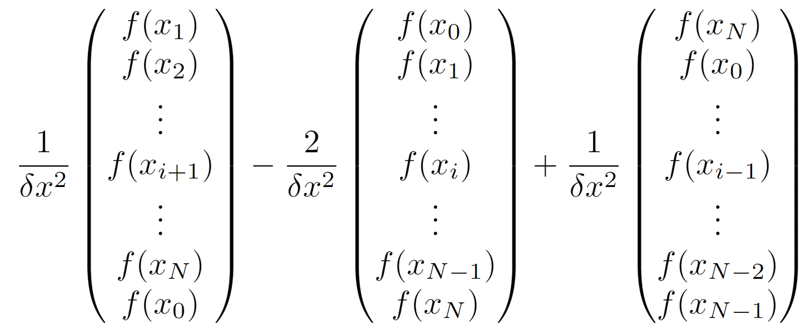
Finite Difference Derivative

Slide 8
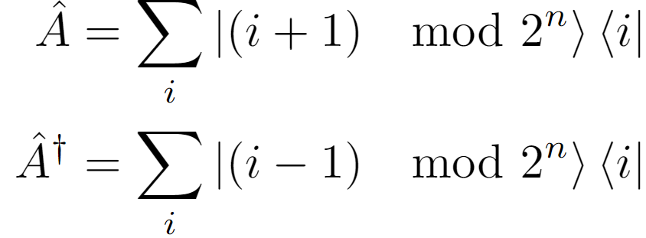
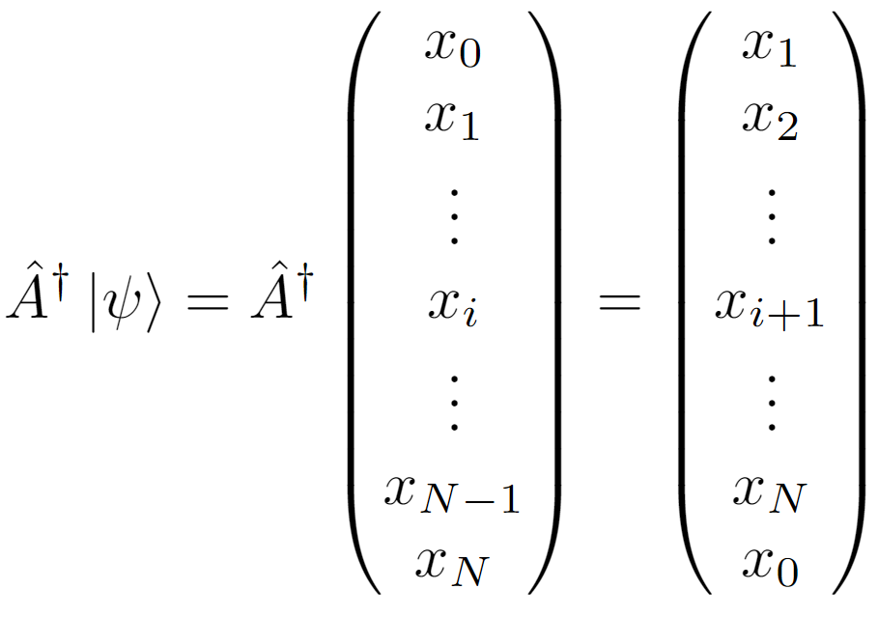
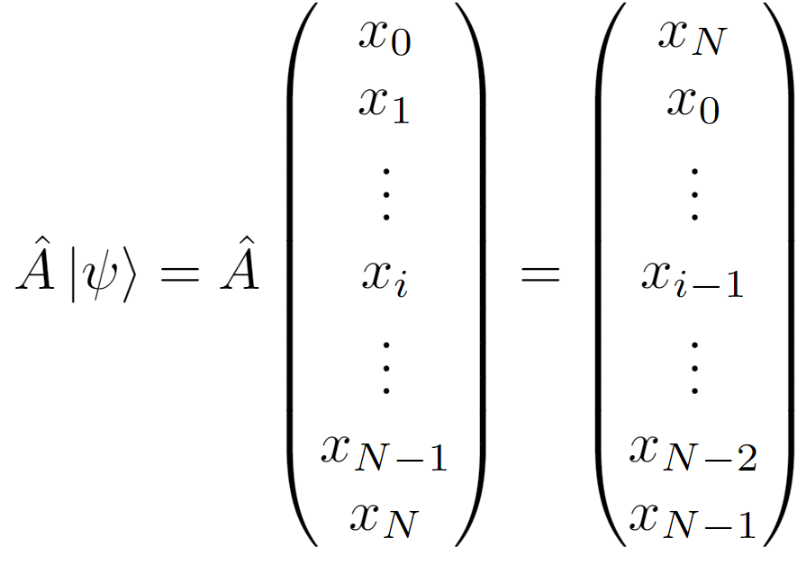
Adder Operator
Notes:
Row vector and column vector

Slide 9
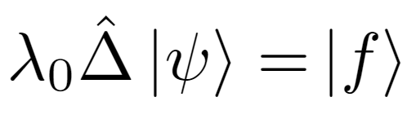
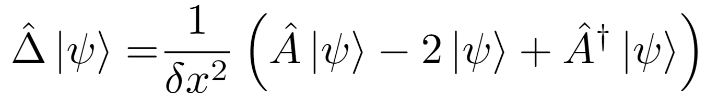
Quantum Finite Difference Derivative
Equivalent to

Slide 10
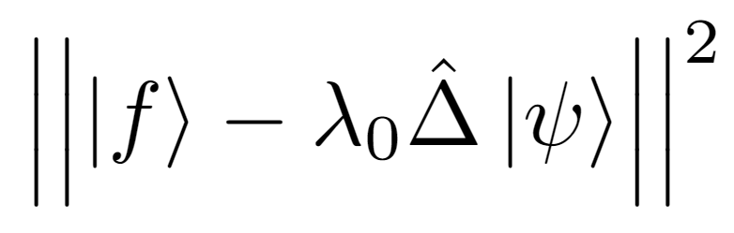
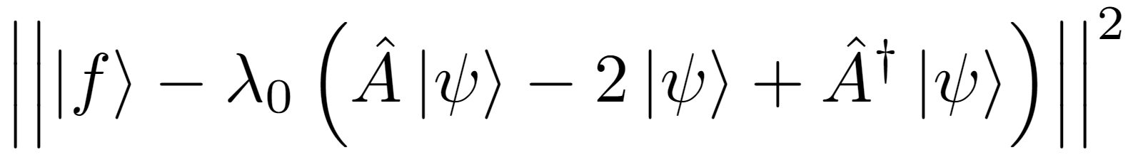
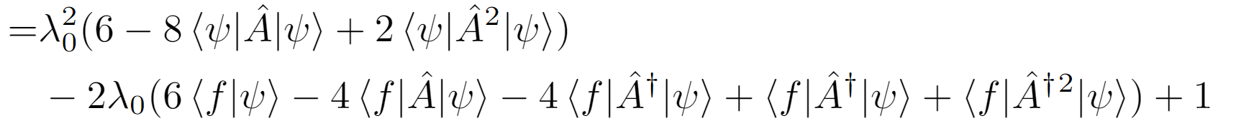
Cost Function
Minimize
Notes:
Remind about inner product

Slide 11
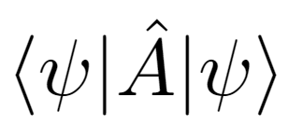
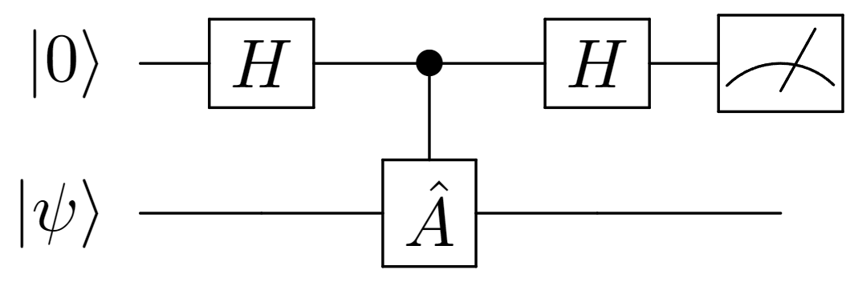
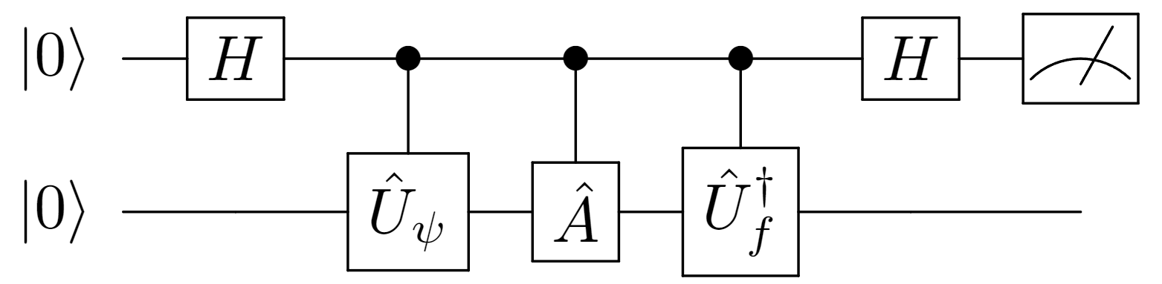
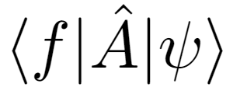
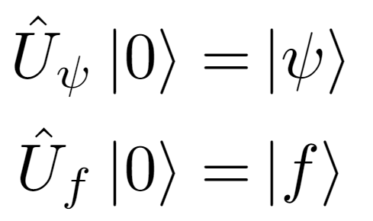
Hadamard Test
So how to compute the expectations such as ?

Slide 12
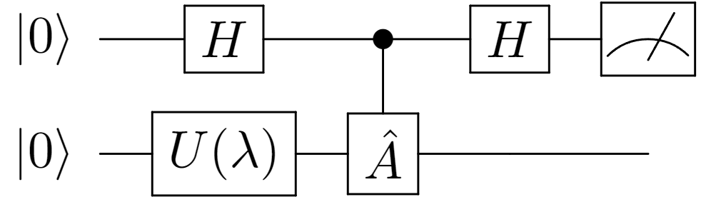
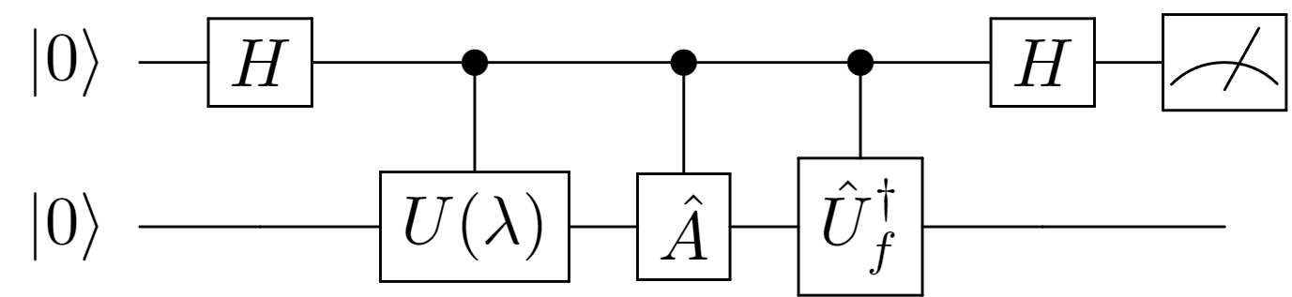
Variational Quantum Algorithm (Updated)
Ansatz Circuit
Cost Function
Initial Parameters
if
return
Classical Optimizer

Slide 13
Can we do better?
Yes!
Energy Minimization Method introduced by Sato et al.[2]

Slide 14
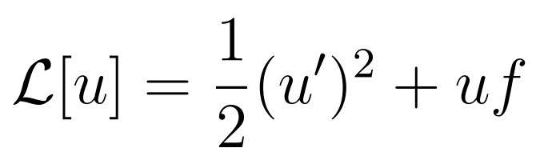
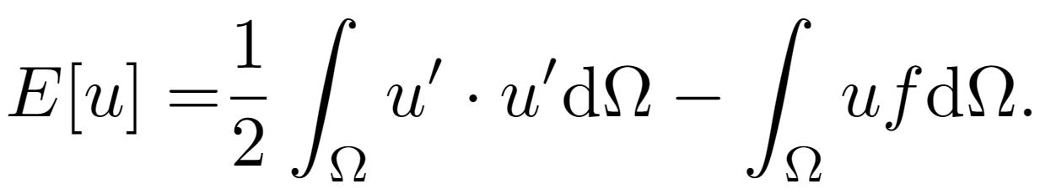
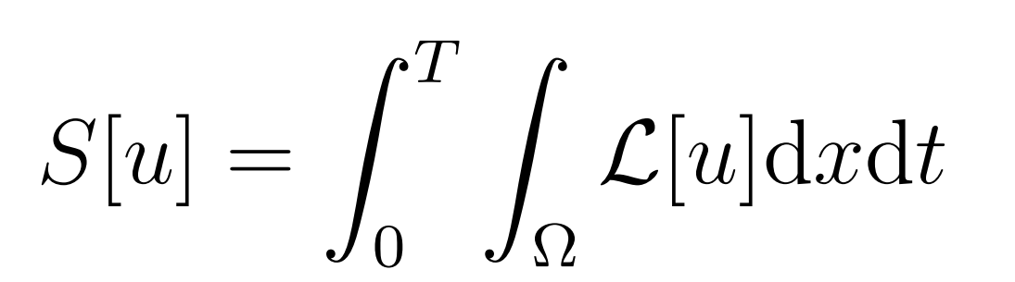
Euler-Lagrange Equation for Poisson Equation
Lagrangian
Action
Minimizing the Action = Solving the PDE!
Notes:
Think of the action as the energy of a physical system

Slide 15
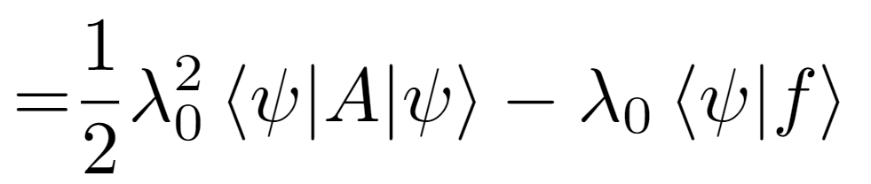
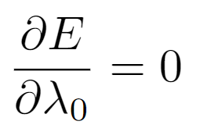
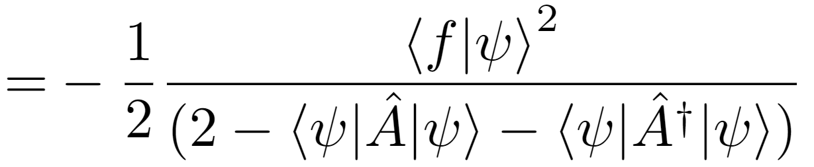
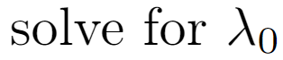
Euler-Lagrange Equation for Poisson Equation

Slide 16
Comparison
7 Expectation Circuits
3 Expectation Circuits!

Slide 17
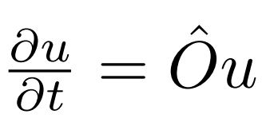

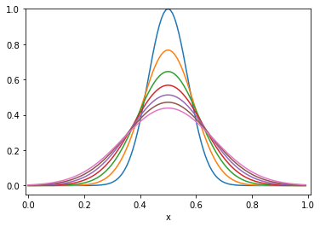
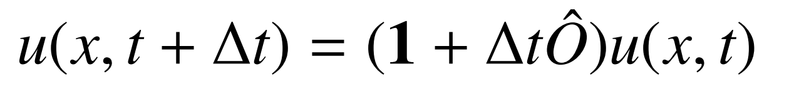
Time-Dependent PDE

Slide 18
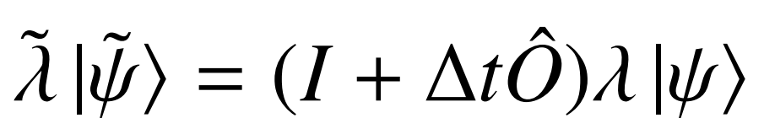
Time-Dependent PDE
Notes:
Lambda is absorbed as well

Slide 19
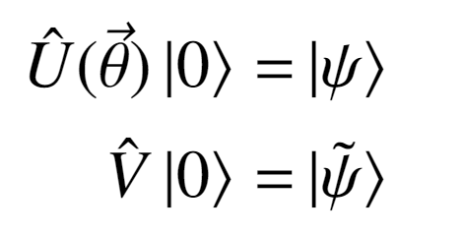
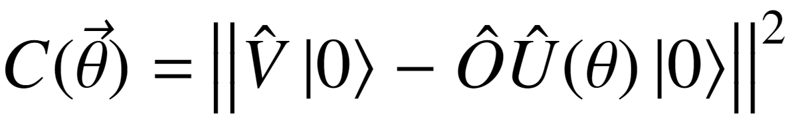
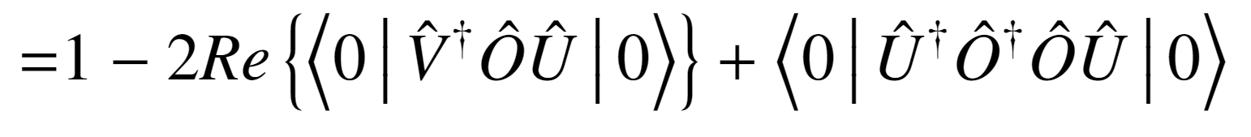
Cost Function

Slide 20
Variational Quantum Algorithm (Updated)
Ansatz Circuit
Cost Function
Initial Parameters
if
return
Classical Optimizer

Slide 21
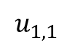
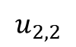
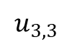
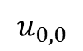













Higher Dimensions
$$\left(\begin{aligned}\begin{matrix}u_{0,0} \\ u_{1,0} \\ \begin{aligned}u_{2,0} \\ u_{3,0} \\ u_{1,0} \\ u_{1,1} \\ u_{1,2} \\ u_{1,3} \\ u_{2,0} \\ u_{2,1}\end{aligned}\end{matrix} \\ u_{2,2} \\ u_{2,3} \\ u_{3,0} \\ u_{3,1} \\ u_{3,2} \\ u_{3,3}\end{aligned}\right)$$
y
$$u_{0,0}$$
$$u_{0,1}$$
$$u_{0,2}$$
$$u_{0,3}$$
$$u_{1,0}$$
$$u_{1,1}$$
$$u_{1,2}$$
$$u_{1,3}$$
$$u_{2,0}$$
$$u_{2,1}$$
$$u_{2,2}$$
$$u_{2,3}$$
$$u_{3,0}$$
$$u_{3,1}$$
$$u_{3,2}$$
$$u_{3,3}$$
x

Slide 22


Higher Dimensions - Derivative

Slide 23


Nonlinearity
Navier-Stokes Equation
We want
Notes:
Now we have the tools to find the cost function for any linear PDE
How about nonlinearity?

Slide 24



Nonlinearity
Not a Unitary Operation!

Slide 25


Nonlinearity
Notes:
This is a very powerful tool

Slide 26





Challenges
Cost Function Design
Ansatz Design
Optimization
Boundary Conditions
Read-Out
The Hilbert Space is Exponentially big!
Need $θ$ << $O(2^{n})$
https://pennylane.ai/qml/demos/tutorial_local_cost_functions.html
Notes:
Cost function: find lagrangian is not trivial
Ansatz: trade off between reducing num of params and expressivity
Opt: barren plateau
Read out: quantum state not accessible

Slide 27


Slide 28
Thank you

